Slide 1

Gradient Descent
evolutions of gradient descent.
stuDYING Gradient Descent Evolution

Slide 2
Gradient Descent
decreasing ‘steps’ every iteration
stuDYING Gradient Descent Evolution

Slide 3
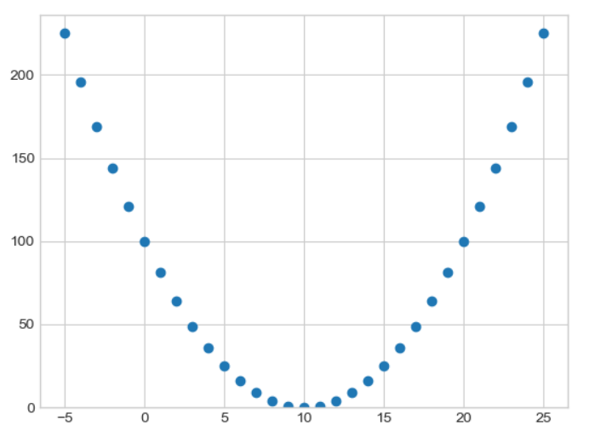
error
COST FUNCTION
Big first step, gradually take smaller step until convergence
C
stuDYING Gradient Descent Evolution
Notes:
Limit x->0

Slide 4
How it works
temp_m = m - 𝞪 * derivative(Cost Function)
temp_C = C - 𝞪 * derivative(Cost Function)
m = temp_m
C = temp_C
stuDYING Gradient Descent Evolution

Slide 5
BATCH GRADIENT DESCENT IS TOO SLOW
steps only taken after all dataset are processed
stuDYING Gradient Descent Evolution

Slide 6
Mini - Batch GRADIENT DESCENT IS BORN
Slice the dataset into several group, update weights after each sub-dataset
Psst… also known as sub-batch
stuDYING Gradient Descent Evolution

Slide 7
Butt wait.
Is Gradient Descent the only optimizer?
no, it is not a typo
stuDYING Gradient Descent Evolution

Slide 8
Introducing
Exponentially Weighted
Average
and
Normal Equation
stuDYING Gradient Descent Evolution

Slide 9

But it is still not FAST enough!
nothing should surprise you anymore at this point
stuDYING Gradient Descent Evolution

Slide 10
Batch Gradient Descent
Mini - Batch
Gradient Descent
Momentum
Gradient Descent
Adaptive
Gradient Descent
Adaptive Momentum
Gradient Descent
take all dataset then update
take part of the dataset then update
step bigger on correct direction
adapting learning rate on correct direction
adapting momentum on correct direction
exponentially weighted average
stuDYING Gradient Descent Evolution

Slide 11
Lets code!
goat damn it!
stuDYING Gradient Descent Evolution

Slide 12
Gradient Ascent
Exists!
stuDYING Gradient Descent Evolution

Slide 13
Missed Agenda:
stuDYING Gradient Descent Evolution

